Slide 1
Open Source Vulnerability Metrics
Dr. Tate
Seth Goodwin, Michael Follari, Jaron Dunham, Gabe Wilmoth, Rohit Gade

Slide 2
Vulnerabilities vs. Software Releases
Task
Statistics of Releases
Hypothesis Test
H0: Weeks after a period of high or low amount of vulnerability discoveries will have the same number of releases as any other week.

Slide 3
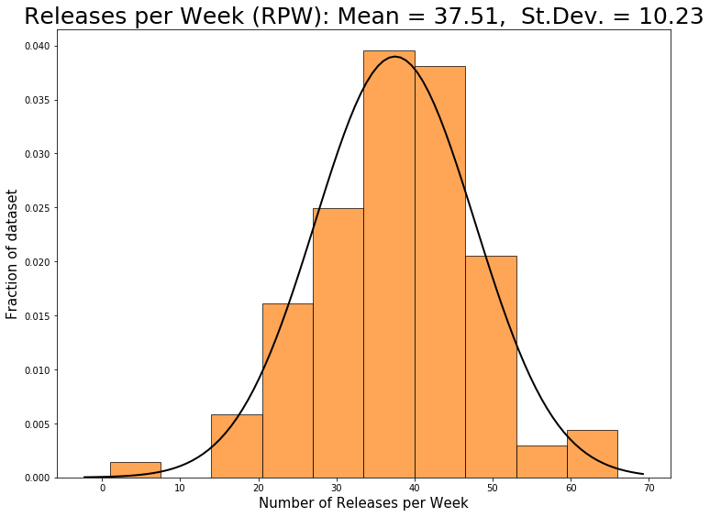
Statistics of Releases
Normal Distribution
Mean: 37.51
Median: 37.0
Std. Dev: 10.23
Variance: 105.7

Slide 4
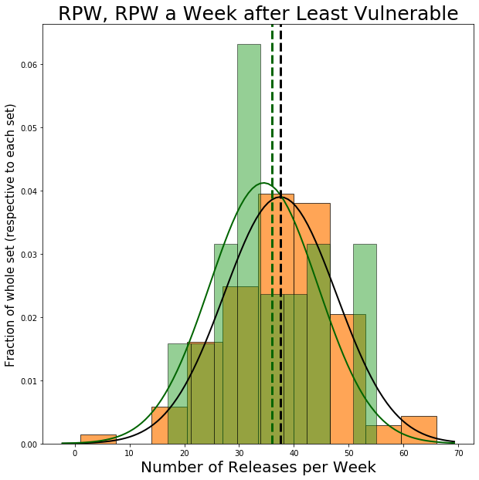
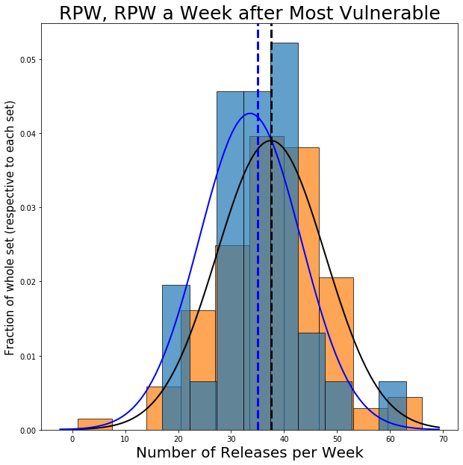
RPW One Week After Vulnerable Weeks

Slide 5
Hypothesis
Two Sample T-Test
P-Value for most vulnerable: 0.244
P-Value for least vulnerable: 0.46
Fail to reject the null hypothesis!
Vulnerability and Release Correlation
Vulnerabilities and Releases: -0.005
V&R most: 0.025
V&R least: -0.023
Not much correlation going on here, huh?

Slide 6
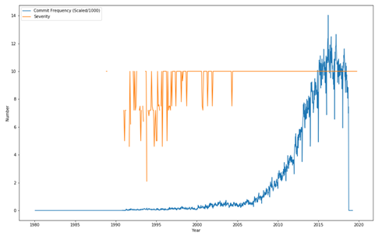
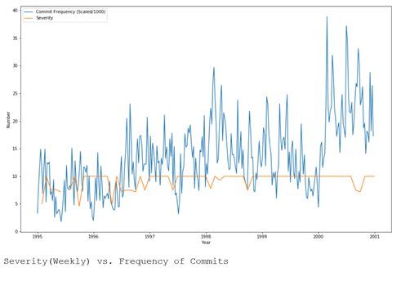

Frequency of Commits Vs. Severity
Comparing the Base Score (severity) of Vulnerabilities from NVD to the frequency of commits, there doesn't seem to be much of a link between the two parameters.
The top graph looks at the 1990s to 2020, although the discrepancy would be due to commits being more common as years go by. Also on this graph it seems like most base scores are in, but as we see the mean is around 6.
Looking at 1995 to 2000, an area with a lot more noticable differences in severity, the link between the two still doesn't seem feasible.
Commit Frequency (Scaled) vs. Severity

Slide 7
NVD JSON to CSV
More efficient algorithm to convert NVD Json to CSV
(Simple) Converts with nested arrays
(Detailed) Creates new rows that include the information from the nested arrays

Slide 8
Vulnerability Publish Date vs. Commit Patch Date
Tasks
More data wrangling
Extracting relevant data for statistical analysis
Statistics of revisions and software vulnerabilities
Distribution modeling
Hypothesis testing

Slide 9
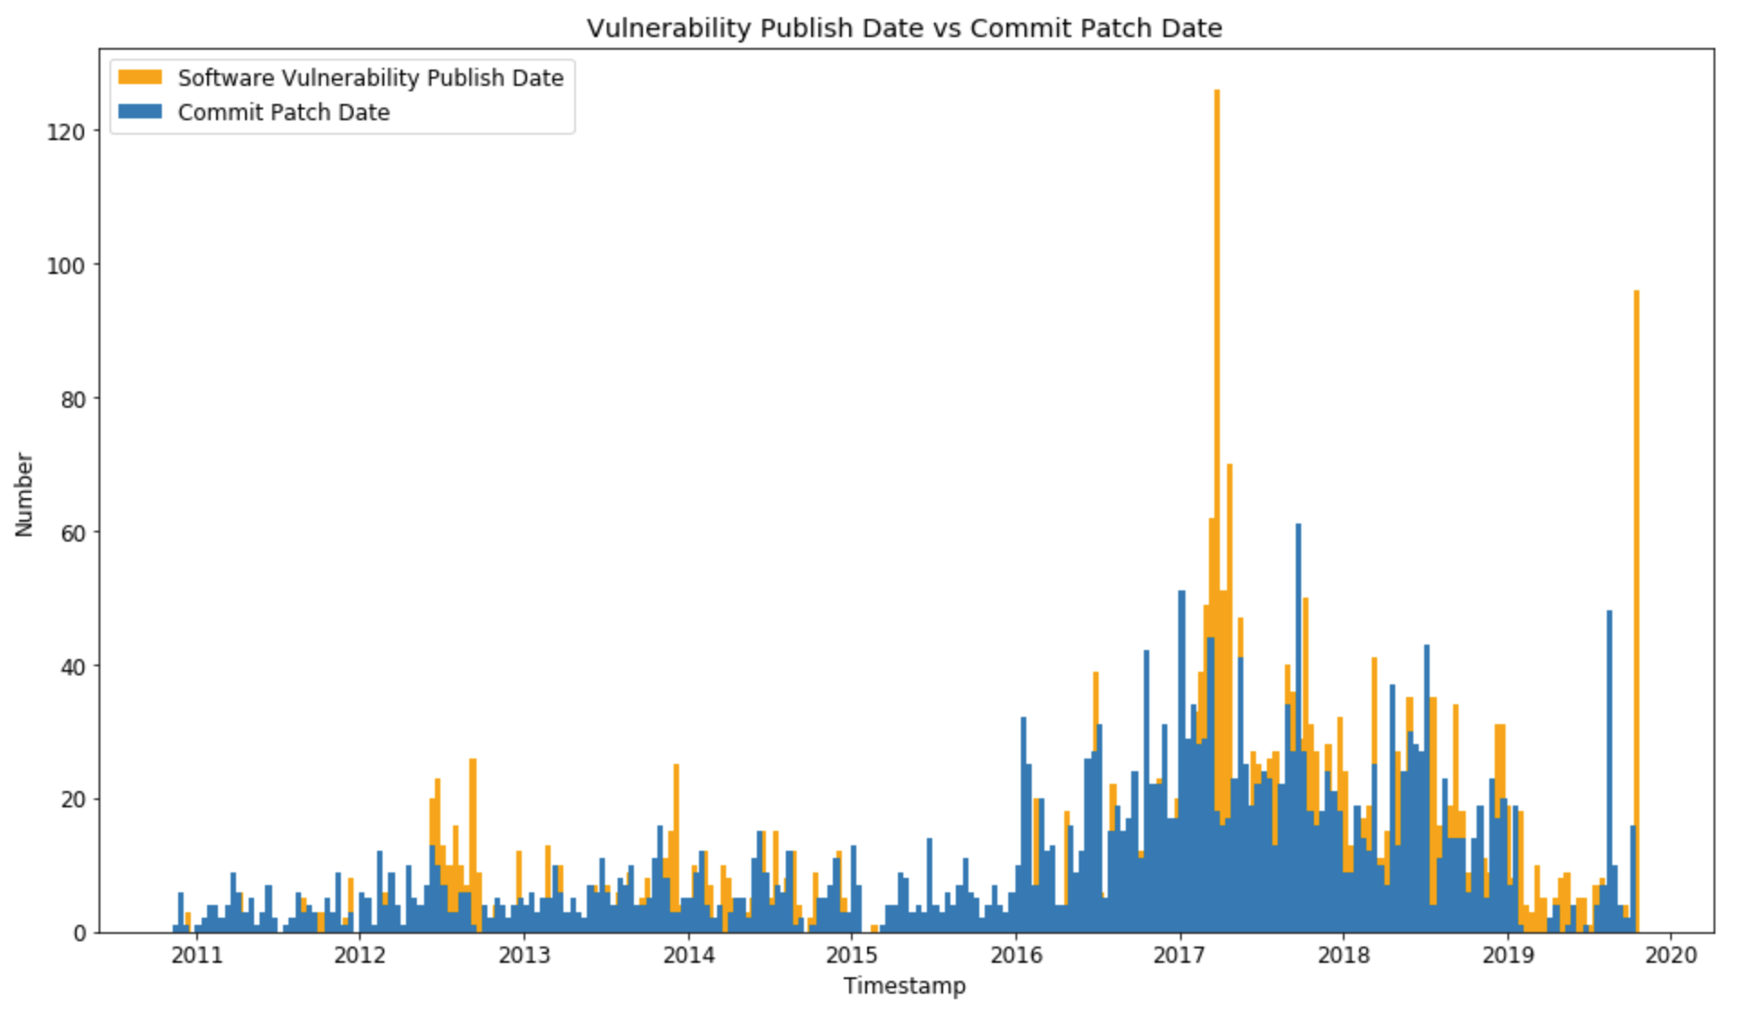
Vulnerability Publish Date vs. Commit Patch Date
Software vulnerabilities patched by GitHub commit

Slide 10
Vulnerability Publish Date vs. Commit Patch Date
Publish date and commit patch date correlation:
Daily: 0.226
Weekly: 0.540
Monthly: 0.701
Yearly: 0.821

Slide 11
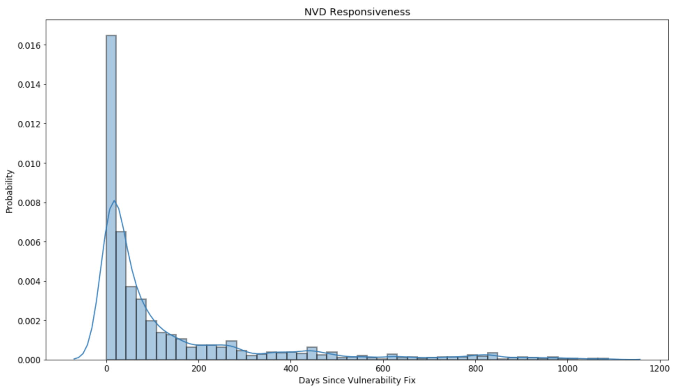
Vulnerability Publish Date vs. Commit Patch Date

Slide 12
Vulnerability Publish Date vs. Commit Patch Date
H0: NVD will publish new software vulnerability info <= 4 months after there is a GitHub commit that fixes the vulnerability.
H1: NVD will publish new software vulnerability info > 4 months after there is a GitHub commit that fixes the vulnerability.
P-value = 7.17e-05 < 0.05 (significance level)
⇒ Reject H0
⇒ Avg time to submit new vulnerability info > 4 months…

Slide 13
Releases vs. New Vulnerabilities
Task:
Look into New Vulnerabilities Statistics
Specifically Vulnerabilities per week

Slide 14
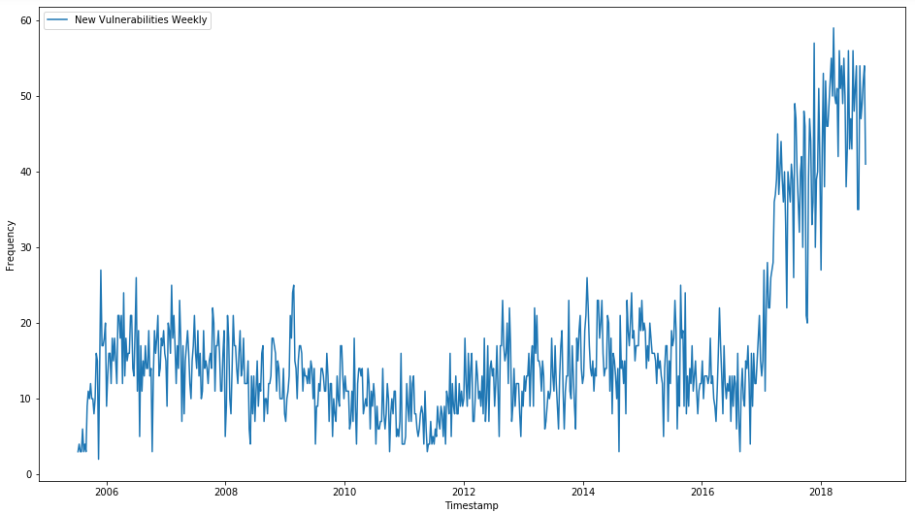
New Vulnerabilities (Per Week)
Large Increase in Vulnerabilities in recent years

Slide 15
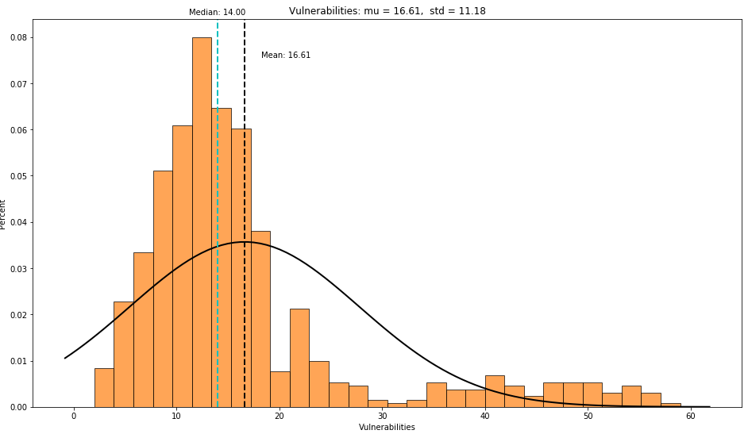
New Vulnerabilities (Per Week)
Obviously data is skewed to the right
Mean: 16.61
Median: 14.00
Std: 11.18
CV: 0.67
Variance: 125.13
Notes:
We do have a large variance as our data is spread out pretty far, but after calculating the coefficient of variation we can see that its below 1 meaning most of the data are close to average.

Slide 16
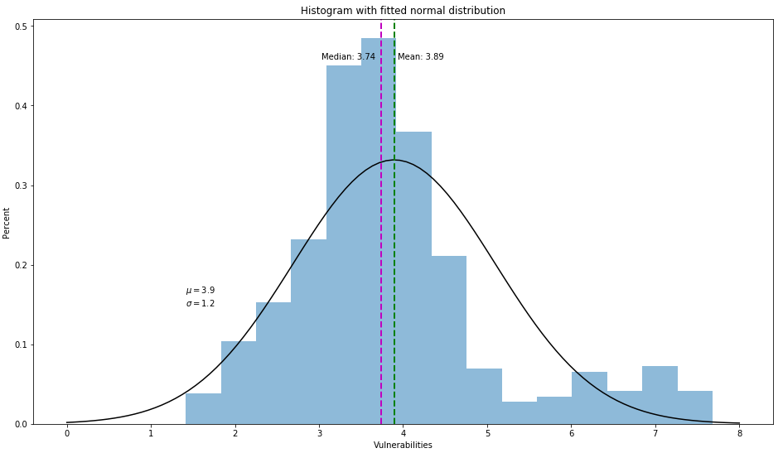
New Vulnerabilities (Per Week)
Square Root of previous histogram results in a more normal distribution.
Mean: 3.89
Median: 3.74
Std: 1.2
CV: 0.31
Variance: 1.45
Notes:
Taking the square root of the previous histogram results in a close to normal distribution in which we can work with.

Slide 17
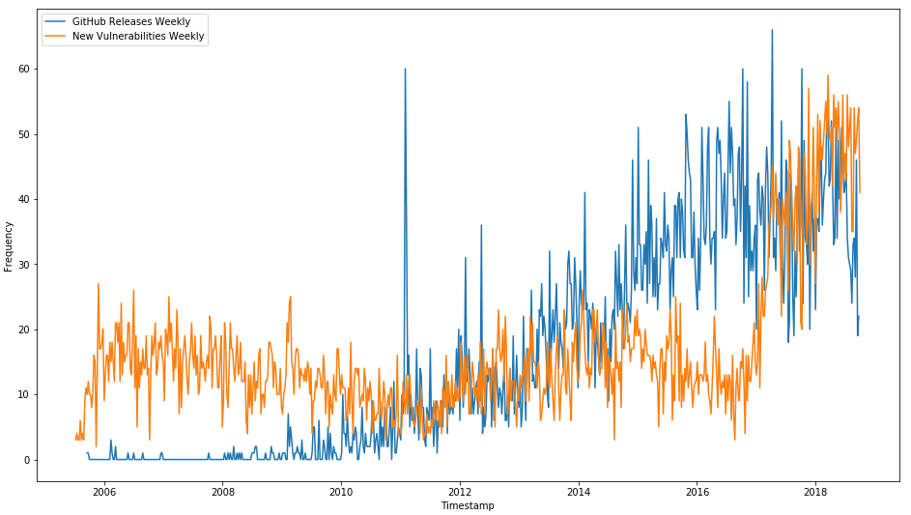
Releases vs. New Vulnerabilities
Overlay of Vulnerabilities and Releases Per Week
Correlation: 0.46
Notes:
When overlaying both releases and vulnerabilities per week we see they don’t line up as expected as Github grows in popularity it tends to have far more releases per week than there are vulnerabilities discovered although vulnerabilities have increased to match it in the past year....
An interesting thing to further investigate would be if there is a spike in releases in the following week or two or following month is there a spike in vulnerabilities...

Slide 18
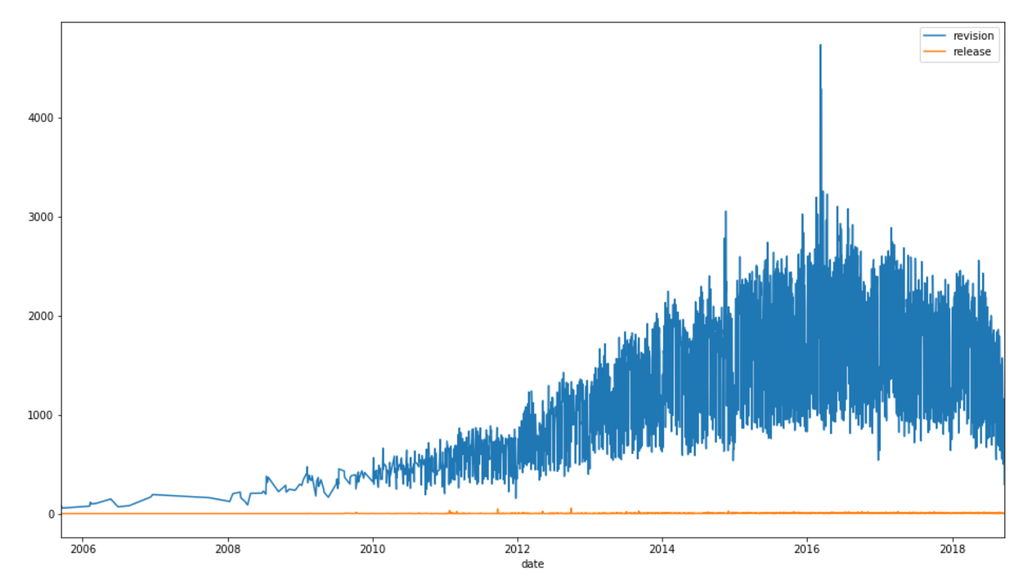
Analysis between revisions ( commits )and releases in general
A plot between
Commits per-day
And releases per
Day over the
years.

Slide 19
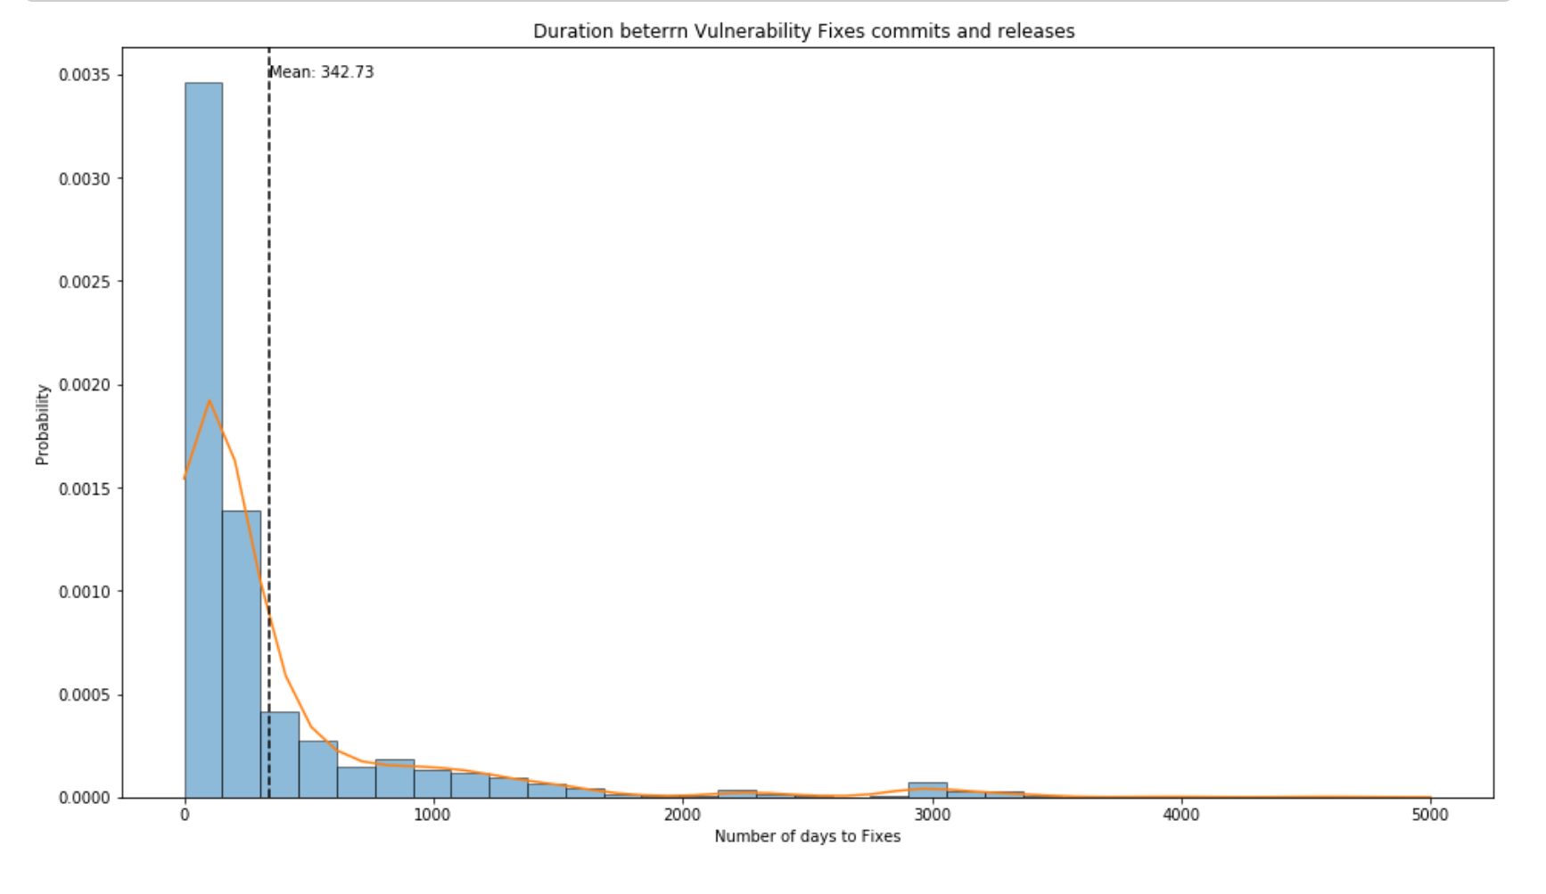
Analysis Between Commits (Vul. Fixes ) and Releases dates.
Applied Normal
Normal Dist.
Observed
Mean: 342.73
SD: 623.8

Slide 20
Questions?

